Slide 1
Parametric Hypothesis Testing
One and two sample t tests

Slide 2
Learning Objectives
This presentation explores the use of Excel and SPSS to describe how you can solve hypothesis test problems for one and two samples.
Given:
Excel can solve both z-test and t-test problems.
SPSS can solve t-test problems.
For this reason the data examples will be solved using the Student’s t-test for one and two samples.
Learning objectives:
Solve one sample and two sample hypothesis tests using the Student’s t-test.
Apply tests to small and large samples
Solve data problems using Excel and SPSS.

Slide 3
Textbook examples
Table 7.1 provides a list of parametric statistical tests described in this textbook together with identification of which methods are solved via Excel and SPSS.
Statistics test | Excel | SPSS
One sample z test for the population mean | Yes | No
One sample t test for the population mean | Yes | Yes
One sample z test for the population proportion | Yes | No
Two sample z test for two independent population means | Yes | No
Two sample z test for two independent population proportions | Yes | No
Two sample t test for two population means (independent samples, equal variance) | Yes | Yes
Two sample t test for two population means (independent samples, unequal variance) | Yes | Yes
Two sample t test for two population means (dependent samples) | Yes | Yes
Two sample F test for two population variances | Online | Online
To illustrate we will now look at examples which can be solved using Excel and SPSS: Student’s t-tests.

Slide 4

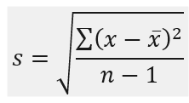
One sample t test for population mean
In many real-world cases of hypothesis testing, one does not know the standard deviation of the population (σ). In such cases, it must be estimated using the sample standard deviation (s). Student’s t-test assumptions:
The sample is a simple random sample from a defined population.
It is assumed that the variables of interest in the population are measured on an interval/ratio scale.
The sampling distribution of the sample means is normal (the Central Limit Theorem tells you when this will be the case)
The population standard deviation is estimated from the sample.
The Student’s t-test given by equation (6.7):
With df = n - 1 degrees of freedom

Slide 5
One Sample t Test for Population Mean -
Example 6.4
A car dealer offers generous package to customers who would like their purchasers to have high quality extras fitted to the cars. Historically, people who access this offer spend £2300 per customer. The owner is concerned that recently this average spend has changed and requested after discussions with a data analyst that this is tested. The analyst recommended a one-sample t-test. To test this hypothesis, the data analyst checked the data for the last five years to confirm that the population spend follows approximately a normal distribution and then collects the spending data for the last seven customers (£): 2220, 2621, 2025, 1890, 2890, 2380, and 1890.
H₀: μ = 2300
H₁: μ ≠ 2300
(Two tail test)
α = 5% = 0.05
Population:
Normally distributed
μ = 2300, σ = unknown
Sample:
n = 7

Slide 6
Example 6.4 solution (1/4)
Step 1 - State hypothesis
Null hypothesis H₀: μ = 2300
Alternative Hypothesis H₁: μ ≠ 2300 (the sign implies a two-tail test)
Step 2 - Select test
Number of samples - one sample.
The statistic we are testing - testing for a difference between a sample mean and population mean (µ = 2300). Therefore, two-tail test. Population standard deviation is not known.
Size of the sample - small (n = 7).
Nature of population from which sample drawn – normal population distribution, sample size is small, and population standard deviation is unknown. The sample standard deviation will be used as an estimate of the population standard deviation and the sampling distribution of the mean is a t distribution with n – 1 degrees of freedom.
We conclude that one sample t test of the mean is appropriate.

Slide 7


Example 6.4 solution (2/4)
Step 3 - Set the level of significance α = 0.05
Step 4 - Extract relevant statistic
The required distribution is a t distribution given by equation (6.7):
Where, population mean = 2300, sample size n = 7, Sample mean = 2273.71, and sample standard deviation s = 380.99. Substituting these values into equation (6.9) gives:

Slide 8
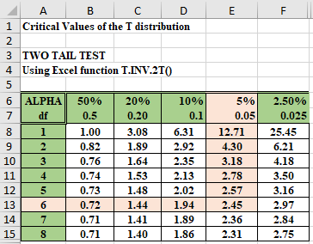
Example 6.4 solution (3/4)
Step 5 - Make a decision - Two alternative approaches considered
From statistical tables, the two-tail critical test statistic t_{cri} = t (0.05/2, 6) = 2.45
The calculated test statistic t_{cal} = - 0.18 and the critical t value ± 2.45 are compared to decide which hypothesis statement to accept.
Given t_{cal} (- 0.18) lies between the lower and upper critical t values (-2.45 → + 2.45), we fail to reject H₀.

Slide 9
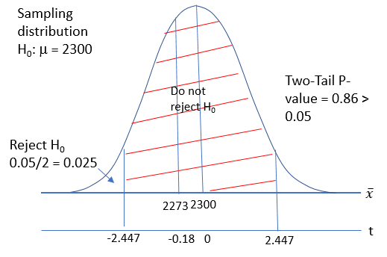
Example 6.4 solution (4/4)
Figure 6.17 illustrates the relationship between the p-value, test statistic, and critical test statistic.
The evidence suggests that there is no significant difference, at the 0.05 level, between the extras purchased by the sample (i.e. the customers today) and the historical extras purchased of £2300.

Slide 10
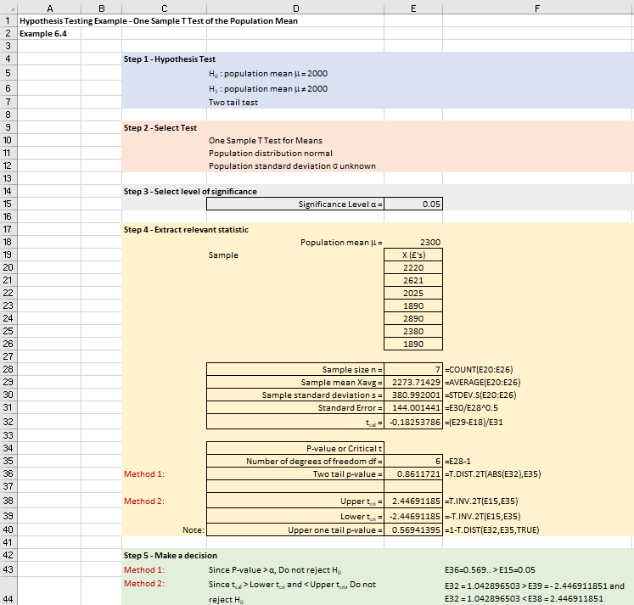
Excel solution
t_{cal} = - 0.18
T_{cri} = ± 2.4469
t_{cal} ( = - 0.18) lies between the lower and upper critical t values (-2.447 → + 2.447), we fail to reject the null hypothesis H₀.
Alternatively, 2-tail p-value = 0.861 > significance level (0.05), we fail to reject the null hypothesis.

Slide 11
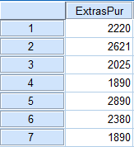
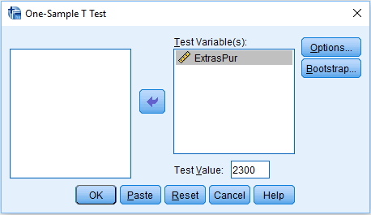
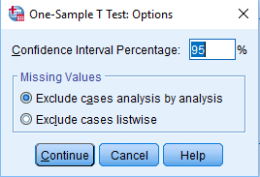
SPSS solution (1/2)
Enter data into SPSS
Select Analyze > Compare Means > One-Sample T Test
Transfer ExtrasPur into Test Variable(s) box
Type 2300 into the Test Value box
Click on Options
Choose 95% confidence interval – given we have a two-tail test with significance level of 5%

Slide 12
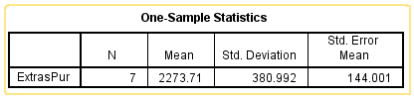
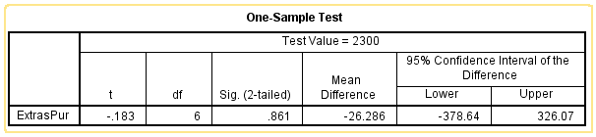
SPSS solution (2/2)
SPSS output
First table gives the one-sample statistics
The second table gives the one-sample hypothesis test results

Slide 13
Two sample t-test for the population mean (independent samples)
In testing for the difference between the means we assume that the populations are normally distributed, with either equal or unequal population variances.
Method 1 Pooled-variance t-test - equal population variances assumed
Method 2 Separate-variance t-test for the difference between two means - unequal population variances

Slide 14
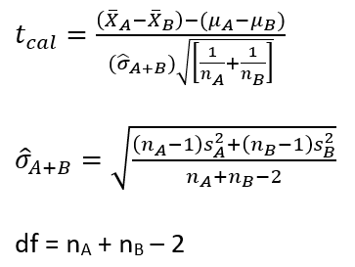

Method 1 Pooled-variance t-test - equal population variances assumed
For situations in which the two populations have equal variances, the pooled-variance t-test is robust to moderate departures from the assumption of normality, provided the sample sizes are large (n₁ ≥ 30, n₂ ≥ 30).In this case, you can use the pooled-variance t-test without serious effects on the power. The test is used to test whether population means are significantly different from each other, using the means from randomly drawn samples. Example: do males and females differ in terms of their exam scores?
Assumptions for the equal-variance t-test:
Both samples are simple random samples.
The two samples must be independent.
The sampling distribution of is normally distributed.
The populations from which you sampled have equal variances.

Slide 15
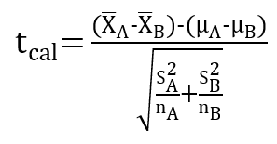
Method 2 Separate-variance t-test for the difference between two means - unequal population variances (1/2)
The assumption of equal variances is critical if the sample sizes are markedly different. Welch developed an approximation method for comparing the means of two independent normal populations when their variances are not necessarily equal. Because Welch’s modified t-test is not derived under the assumption of equal variances, it allows users to compare the means of two populations without first having to test for equal variances.
With equations (6.17) – (6.19), we assumed that the variances were equal for the two samples and conducted a two-sample pooled t test. If the variances are unequal, we should not use these equations but use the Welch’s unequal variances t-test statistic defined by equations (6.20) – (6.21):

Slide 16
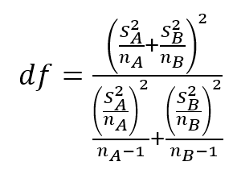
Method 2 Separate-variance t-test for the difference between two means - unequal population variances (2/2)
Here, s_{A}² and s_{B}² are the unbiased estimators of the two samples. Unlike in Student's t-test, the denominator is not based on a pooled variance estimate. For use in significance testing, the distribution of the test statistic is approximated as an ordinary Student’s t distribution with the degrees of freedom calculated using the Welch–Satterthwaite equation:
Assumptions for the unequal-variance t test:
Both samples are simple random samples.
The two samples must be independent.
The sampling distribution of is normally distributed.

Slide 17
Two independent t-test
Example 6.6
Organic beans are packed in bags and sold by two local shops. The local authority has received complaints from customers that the number of beans within the bags sold by the two shops are significantly different. To test this statistically two small random samples were collected from both shops. Conduct a two-sample t test for the population mean to test this hypothesis with a 5% significance level (assume sampling distributions are normally distributed).
Shop A | Shop A | Shop A | Shop B | Shop B | Shop B | Shop B
427 | 569 | 588 | 432 | 434 | 420 | 420
488 | 517 | 468 | 550 | 560 | 580 | 423
534 | 445 | 520 | 590 | 580 | 432 | 420
510 | 540 | 550 | 434 | 440 | 589 | 415
445 | 523 |  | 468 | 458 | 424
550 | 500 |  | 423 | 465 | 580
540 | 528 |  | 424 | 420 | 454
In this case, we are not told if the population variances are equal or unequal.

Slide 18
Example 6.6 solution (1/6)
Step 1 - State hypothesis
Null hypothesis H₀: μ_{Α} = μ_{Β}
Alternative Hypothesis H₁: μ_{Α} ≠ μ_{Β}
The ≠ sign implies a two-tail test.
Step 2 - Select test
From the information provided we note:
Number of samples - two samples.
The statistic we are testing - testing that the amount of beans in a bag sold by both shops are the same. Both population standard deviations are unknown.
Nature of population from which sample drawn - population distributions are normally distributed.

Slide 19
Example 6.6 solution (2/6)
Step 3 - Set the level of significance α = 0.05
Step 4 - Extract relevant statistic
Summary statistics:
Sample statistic | Sample A | Sample B
Sample size | 18 | 25
Sample mean | 513.44’ | 473.50
Sample standard deviation | 44.23 | 66.94

Slide 20
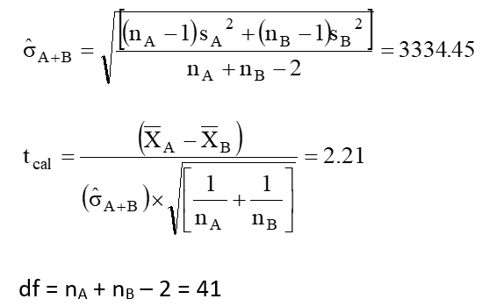
Example 6.6 solution (3/6)
Equal population variances assumed

Slide 21
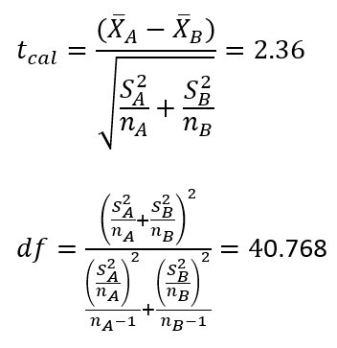
Example 6.6 solution (4/6)
Unequal population variances assumed

Slide 22
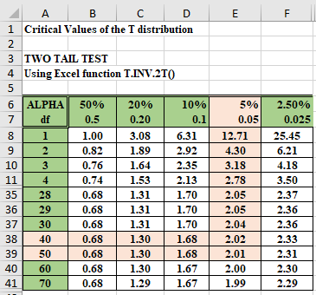
Example 6.6 solution (5/6)
Step 5 - Make a decision
Method 2 Unequal population variances assumed
Using t test statistic and critical test statistic
From statistical tables, calculate tcri = t (0.05/2, 40.768)?
Using linear interpolation to calculate critical value of t when 5% two-tail significance level and 40.768 degrees of freedom to give t_{cri} = 2.02.
Given the t_{cal} (2.21) > upper two tail t_{cri} (2.02), we will reject H₀ and accept the alternative hypothesis H₁.

Slide 23
Example 6.6 solution (6/6)
Method 1 Equal population variances
The critical value of the t test statistic from tables is t_{cri} = ± 2.02 for a two tail, 5% significance, and 41 degrees of freedom.
Does the test statistic lie within the region of rejection?
The calculation of t yields a value of 2.36 and lies within the region of rejection for H₀.
Given that t_{cal} (2.36) > upper two tail t_{cri} (2.02), we will reject H₀ and accept H₁.
We conclude that based upon the sample data collected that we have evidence that the quantity of beans sold by shops A and B is different at the 5% level of significance.

Slide 24
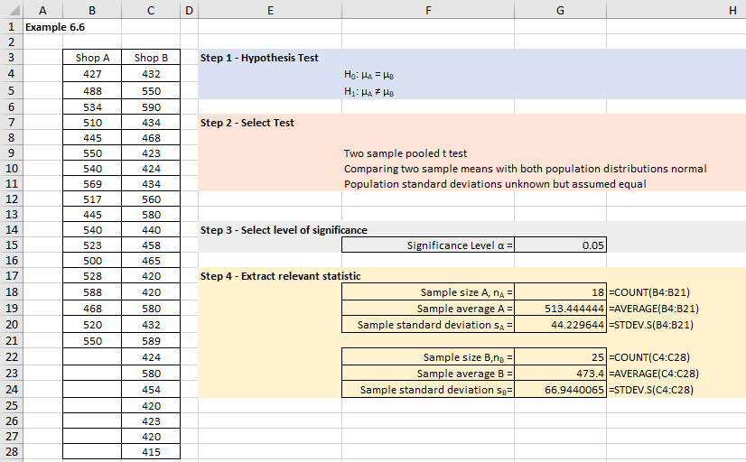
Excel solution (1/3)

Slide 25
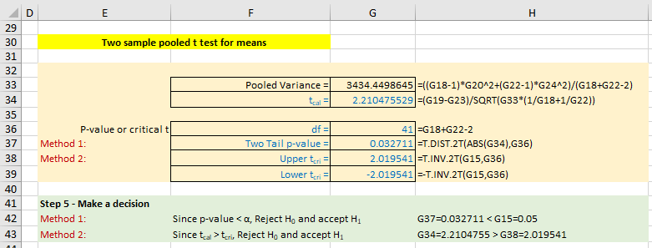
Excel solution (2/3)
Method 1 Equal population variances assumed

Slide 26
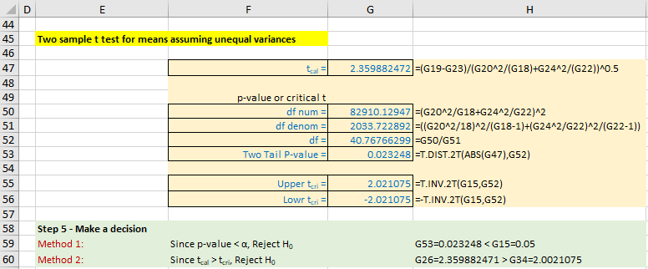
Excel solution (3/3)
Method 2 Unequal population variances assumed

Slide 27
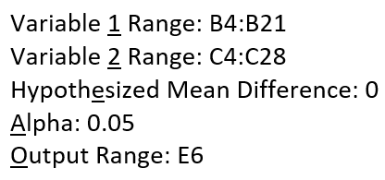
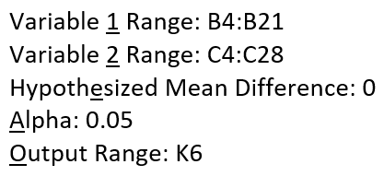
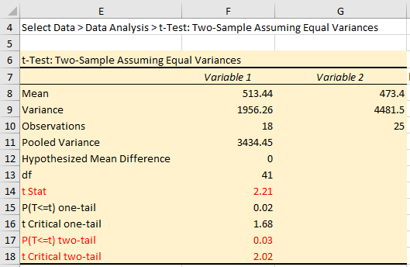
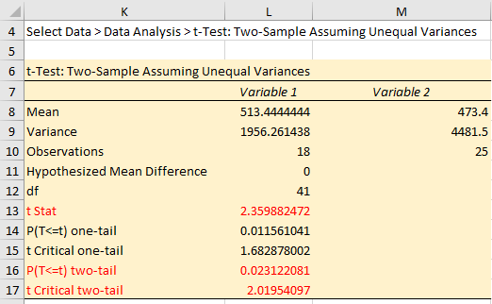
Excel Data Analysis solutions
Method 1 t-Test: Two Sample Assuming Equal Variances.
Method 2 t-Test: Two Sample Assuming Unequal Variances

Slide 28
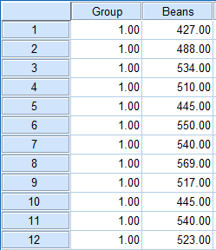
SPSS solution (1/3)
Enter data into SPSS – Figure 6.42 is the first 12 records out of a total of 43 records.
Given that we have a 2-sample independent test to perform then we have created two variables for SPSS:
Group variable: 1 and 2 representing shop A and B respectively.
Beans – represents the number of beans in each bag for Shap A and B – note that a shop A value is paired with a group value of 1 and a shop B value is paired with a group value of 2.

Slide 29
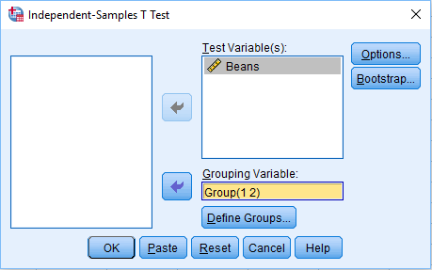
SPSS solution (2/3)
Analyze > Compare Means > Independent-Samples T Test
Transfer variable Beans into Test Variable(s) box
Transfer Group variable into Grouping Variable box
Click on Define Groups and type 1 in the Group 1 box and 2 in the Group 2 box
Click Continue
Click on Options
Type 95% in the Confidence Interval Percentage box
Click Continue
Click Ok

Slide 30
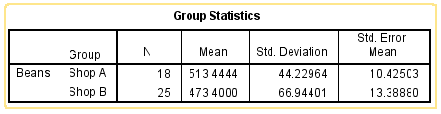
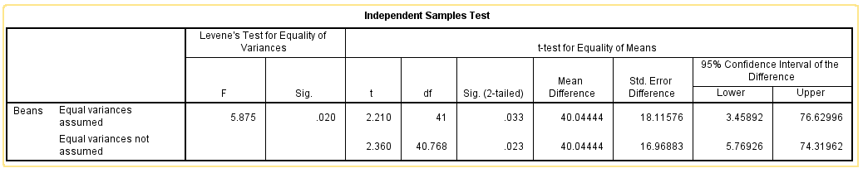
SPSS solution (3/3)
The first table gives the group statistics for shop A and B.
The second table gives the hypothesis test results for the 2-sample independent t test results.

Slide 31
Two sample t-test for the population mean (dependent or paired samples) (1/2)
Another common application of the t-test occurs when you have either 2 scores for each person (e.g. before and after), or when you have matched pairs of scores (e.g. weight before and weight after for a participant).
The paired samples t-test may be used in this case, given that its assumptions are met adequately. The null hypothesis for this paired samples t-test is that the difference scores are a random sample from a population in which the mean difference has some value which you specify.
The test assumptions are as follows:
The samples are simple random samples.
The sample data consist of matched pairs.
The number of matched pairs are large (n ≥ 30) or the paired differences from the population are approximately normally distributed.

Slide 32
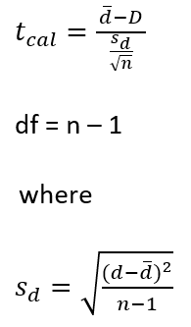
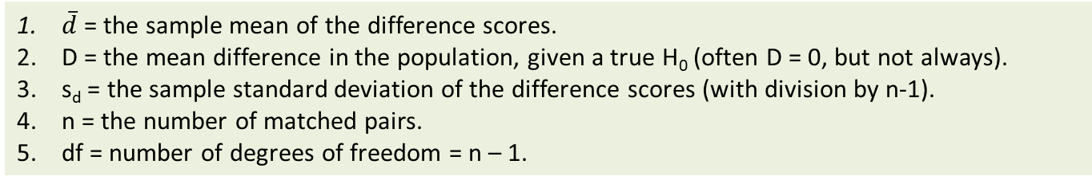
Two sample t-test for the population mean (dependent or paired samples) (2/2)
The t test statistic is given by equation (6.22) with the number of degrees of freedom given be equation (6.23):
(6.22)
(6.23)
(6.24)
where
$\overline{d}$ = the sample mean of the difference scores.
D = the mean difference in the population, given a true H₀ (often D = 0, but not always).
s_{d} = the sample standard deviation of the difference scores (with division by n-1).
n = the number of matched pairs.
df = number of degrees of freedom = n – 1.

Slide 33
Two sample t-test for the population mean (dependent or paired samples)
Example 6.7
Suppose that Super Slim is offering a weight reduction program that they advertise will result in more than a 10-lb weight loss in the first 30 days. Twenty-six subjects were independently randomly selected for a study and their weights before and after the weight loss program were recorded. Super Slim have stated that the historical data shows that the populations are normally distributed. Conduct a two-sample t test for population mean (dependent or paired samples to test this hypothesis.
Before weight | After weight | Before weight | After weight | Before weight | After weight | Before weight | After weight
170 | 170 | 178 | 128 | 161 | 142 | 154 | 140
159 | 153 | 141 | 152 | 156 | 149 | 147 | 125
162 | 129 | 163 | 142 | 165 | 136 | 156 | 141
153 | 143 | 154 | 140 | 158 | 154 | 155 | 146
177 | 137 | 159 | 154 | 151 | 140 | 169 | 135
167 | 134 | 159 | 143 | 165 | 145
158 | 133 | 138 | 147 | 155 | 125

Slide 34
Example 6.7 solution (1/4)
Step 1 - State hypothesis
The hypothesis statement implies that the population mean weight loss between A and B should be at least 10Ibs. If D = μ_{Α} - μ_{Β} = 10 Ibs, then the null and alternative hypotheses would be stated as follows:
Null hypothesis H₀: D ≤ 10
Alternative Hypothesis H₁: D > 10 (or D – 10 > 0)
The > sign implies an upper one tail test
Step 2 - Select test
We now need to choose an appropriate statistical test for testing H₀. From the information provided we note:
Number of samples - two samples.
The statistic we are testing - testing that the weight reduction programme results in a weight loss. Both population standard deviations are unknown.
Size of both samples small (n_{A} and n_{B} = 26).
Nature of population from which sample drawn - population distribution is not known we will assume that the population is approximately normal given sample size is close to 30.

Slide 35
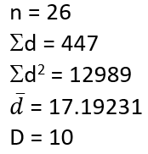
Example solution (2/4)
Step 3 - Set the level of significance α = 0.05
Person | Before Weight, B | After Weight, A | d = B - A | d^2
1 | 170 | 170 | 0 | 0
2 | 159 | 153 | 6 | 36
3 | 162 | 129 | 33 | 1089
4 | 153 | 143 | 10 | 100
5 | 177 | 137 | 40 | 1600
6 | 167 | 134 | 33 | 1089
7 | 158 | 133 | 25 | 625
8 | 178 | 128 | 50 | 2500
9 | 141 | 152 | -11 | 121
10 | 163 | 142 | 21 | 441
11 | 154 | 140 | 14 | 196
12 | 159 | 154 | 5 | 25
13 | 159 | 143 | 16 | 256
14 | 138 | 147 | -9 | 81
15 | 161 | 142 | 19 | 361
16 | 156 | 149 | 7 | 49
17 | 165 | 136 | 29 | 841
18 | 158 | 154 | 4 | 16
19 | 151 | 140 | 11 | 121
20 | 165 | 145 | 20 | 400
21 | 155 | 125 | 30 | 900
22 | 154 | 140 | 14 | 196
23 | 147 | 125 | 22 | 484
24 | 156 | 141 | 15 | 225
25 | 155 | 146 | 9 | 81
26 | 169 | 135 | 34 | 1156
Step 4 - Extract relevant statistic

Slide 36
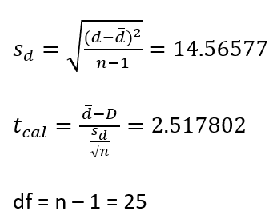
Example solution (3/4)
Substituting these values into equation (6.24), (6.22), and (6.23):

Slide 37
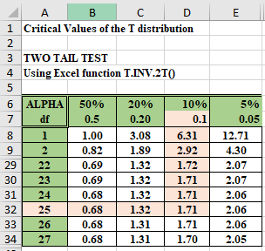
Example solution (4/4)
Step 5 - Make a decision
Calculate t_{cri} from statistical tables
From statistical tables, t_{cri} = t (0.05, 25) = + 1.71.
Conclude that the evidence suggests that the average weight loss is more than 10 Ibs at a 5% level of significance.

Slide 38
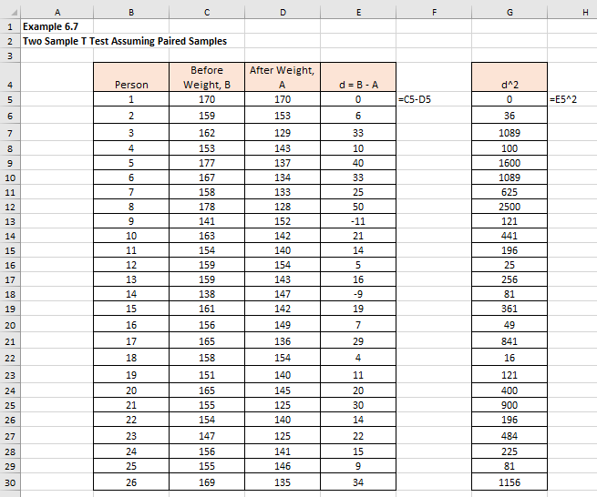
Excel solution (1/2)

Slide 39
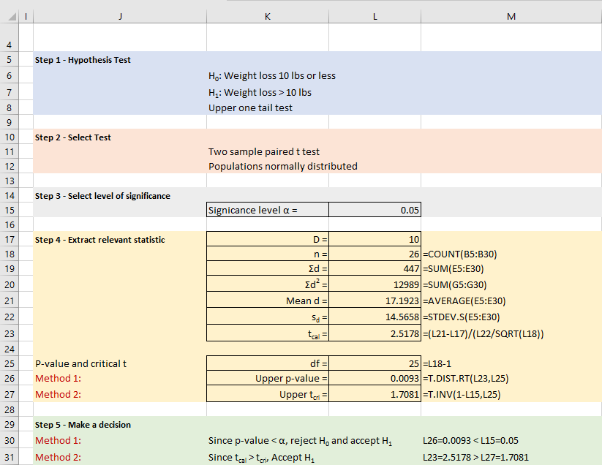
Excel solution (2/2)
α = 0.05
t_{cal} = 2.5178
Upper tail:
t_{cri} = 1.7081
p-value = 0.0093
Tcal > tcri (2.5 > 1.7)
P-value < sig. level
(0.0093 < 0.05)
Accept H₁
Conclude that the evidence suggests that the average weight loss is more than 10 Ibs at a 5% level of significance.

Slide 40
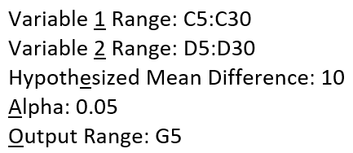
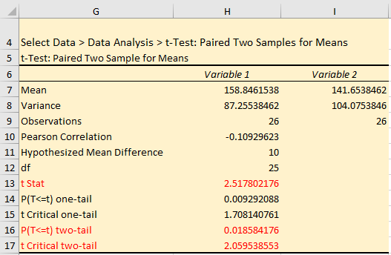
Excel Data Analysis solution
As an alternative, we can use a method embedded in Excel Data Analysis.
Select Data > Data Analysis > T Test: Paired Two Sample for Means
α = 0.05
t_{cal} = 2.5178
Upper tail:
t_{cri} = 1.7081
p-value = 0.00929…
Tcal > tcri (2.5 > 1.7)
P-value < 0.05
Accept H₁

Slide 41
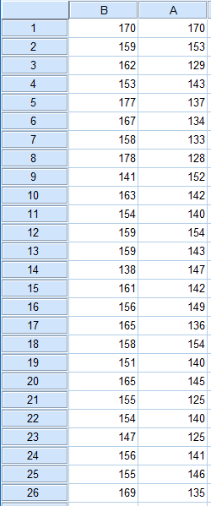
SPSS solution (1/4)
Input data into SPSS

Slide 42
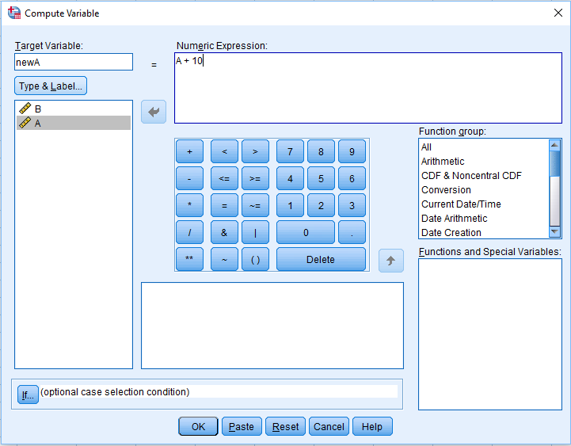
SPSS solution (2/4)
Given that H₀: D = B - A ≤ 10 and H₁: D = B - A > 10.
The null hypothesis can be written as B – A – 10 ≤ 0.
To solve this problem in SPSS we need to create a new variable in the third column called newA where newA = A + 10.
We then perform the 2-sample dependent t test on column B and column newA.
Select Transform > Compute Variable
Click OK

Slide 43
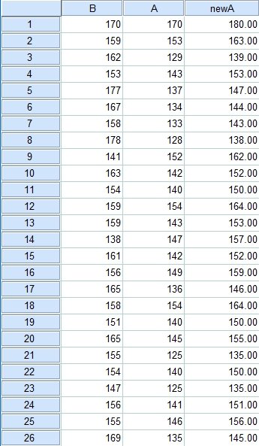
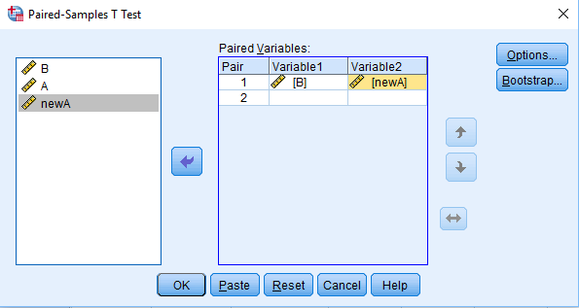
SPSS solution (3/4)
Analyze > Compare Means > Paired-Samples T Test
Transfer variables B and newA into the Paired Variables box
Click OK

Slide 44
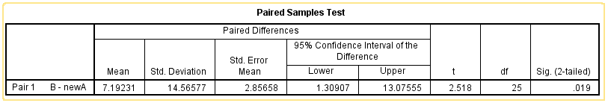
SPSS solution (4/4)
SPSS output
= 0.05
df = 25
t_{cal} = 2.5178
SPSS Sig. (2-tailed) = 0.019 to 3 decimal places
∴ Upper one-tail p-value = 0.019/2 = 0.0095
P-value = 0.0095 < 0.05
Accept H₁

Slide 45
Conclusion
In this presentation we explored the concept of hypothesis testing:
Parametric hypothesis testing
One and two sample tests
Student’s t tests

